Slide 1
Alphabets and Languages
Aman Shakya

Slide 2
Alphabets and Languages
Alphabet: a finite set of symbols, eg,
Roman alphabet {a, b, ... , z}
binary alphabet {O, I}.. Etc.
A String over an alphabet is a finite sequence of symbols from the alphabet
watermelon is a string over the alphabet {a,b, ... ,z}, and 0111011 is a string over {O,I}
empty string and is denoted by e
We will generally use u, v, x, y, z, and Greek letters to denote strings. Eg, w = abc

Slide 3
Strings
The set of all strings, including the empty string, over an alphabet Σ is denoted by Σ*.
The length of a string is its length as a sequence
We denote the length of a string w by Iwl
A string w ϵ Σ* can be considered as a function w : {1, ... , Iwl} → Σ.
Eg, if w = accordion, then w(3) = w(2) = c, and w(1) = a.
The symbol σ ϵ Σ occurs in the j^{th} position of the string w ϵ Σ* if w(j) = σ

Slide 4
Strings
The concatenation of strings x and y, written
x o y or simply xy, is the string x followed by the string y.
concatenation is associative: (wx)y = w(xy) for any strings w, x, and y.
A string v is a substring of a string w if and only if there are strings x and y such that w = xvy.
Both x and y could be e, so every string is a substring of itself
If w = xv for some x, then v is a suffix of w; if w = vy for some y, then v is a prefix of w

Slide 5
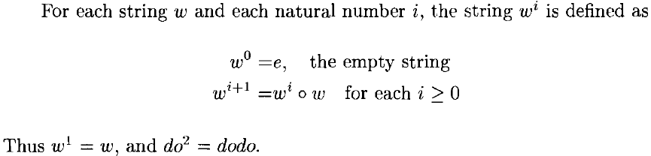
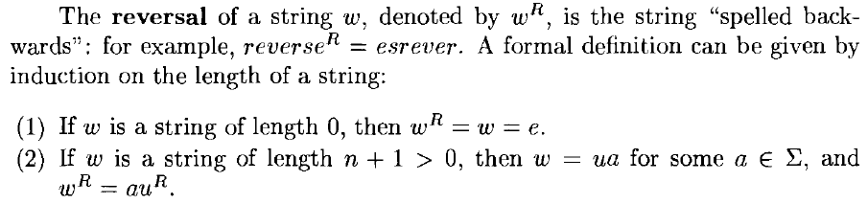
Strings

Slide 6
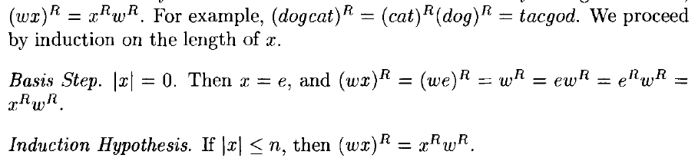
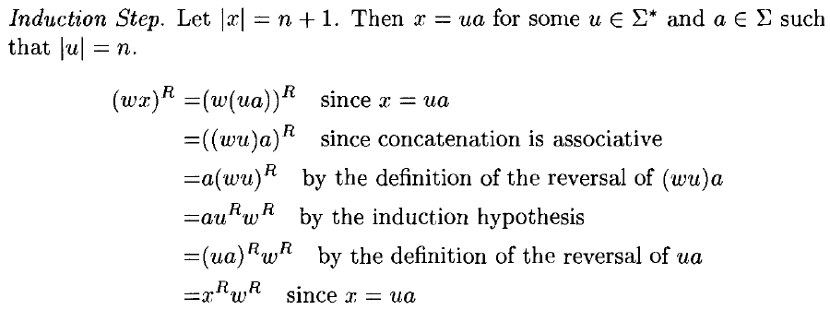
Example
For any strings w and x show that

Slide 7
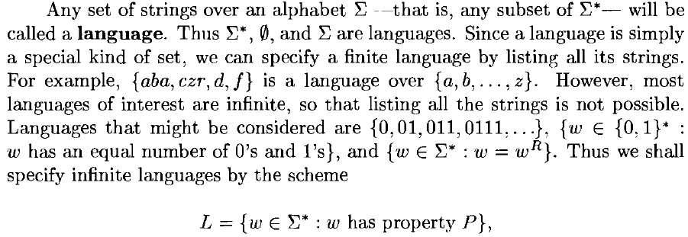
Language

Slide 8
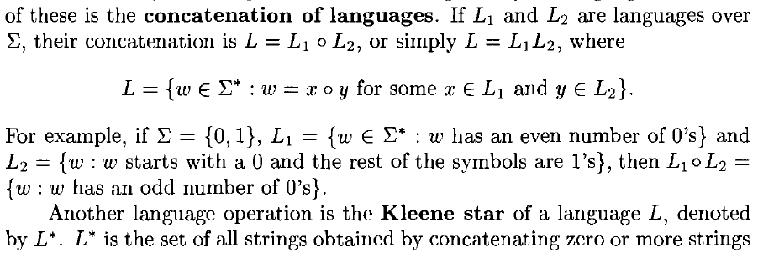
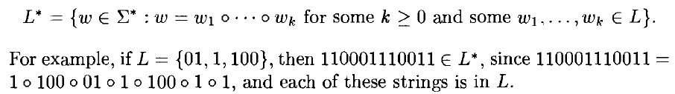
Language

Slide 9
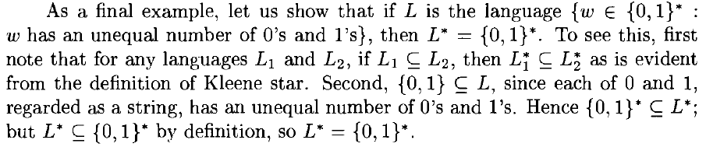
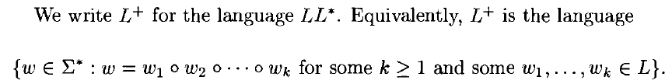
Language

Slide 10
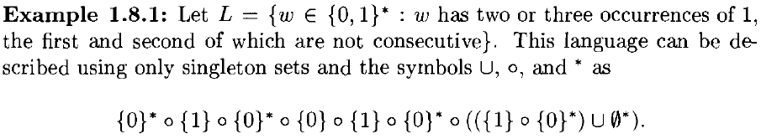

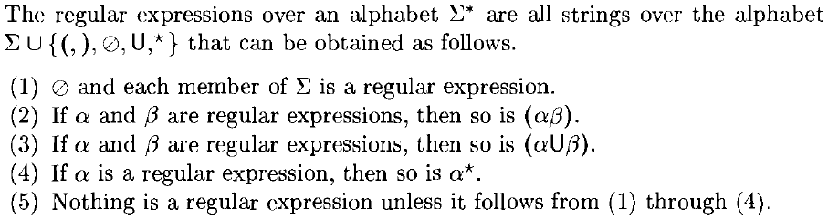
Finite Representation of Languages
Regular Expressions

Slide 11
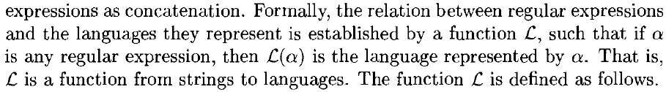
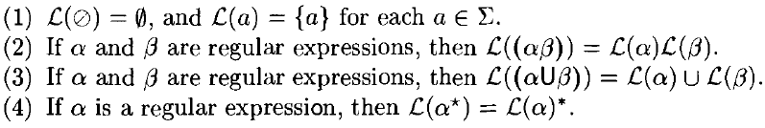
Regular Expressions

Slide 12
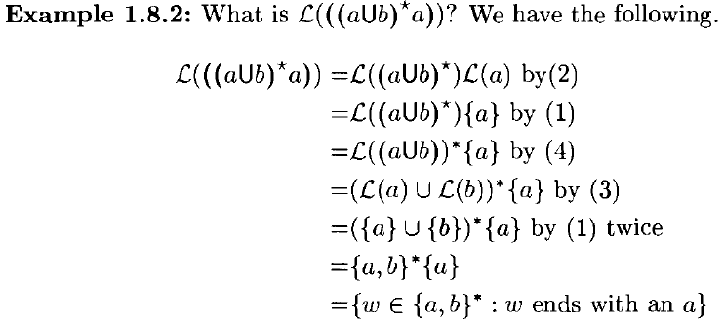
Regular Expressions

Slide 13
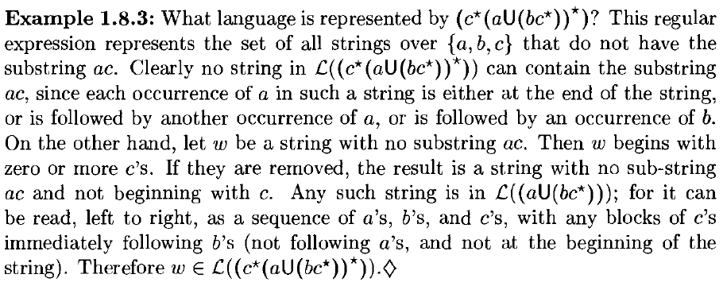
Regular Expressions

Slide 14
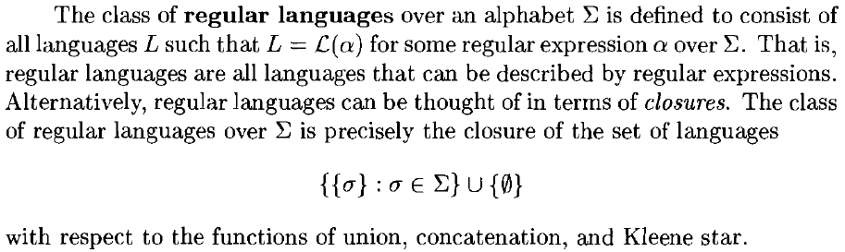
Regular Languages

Slide 15
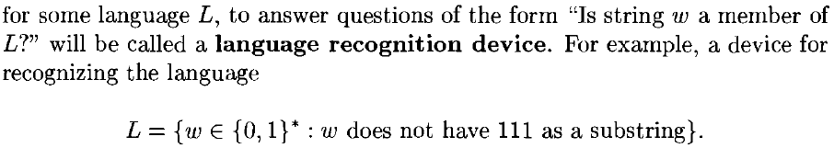
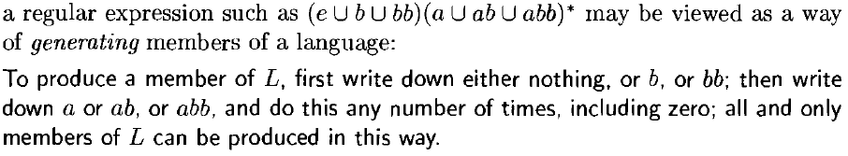
Language Recognition and Generation

